Slide 1

Monitoring PostgreSQL on Premises
Andrea Gnemmi
andrea.gnemmi@gmail.com
a.gnemmi@logifuture.com

Slide 2
Sponsors & Organizers

Slide 3

Who am I?
andrea.gnemmi@gmail.com
a.gnemmi@logifuture.com
https://www.logifuture.com/
https://www.mssqltips.com/sqlserverauthor/390/andrea-gnemmi/
https://www.linkedin.com/in/andreagnemmi/

Slide 4
Monitoring PostgreSQL on premises
In this session we will review some of the monitoring tools available in PostgreSQL
In particular we will see the cumulative statistics system view pg_stat_activity and the pg_stat_statement extension
We will also check how to use the system view pg_locks and what offers the pgAdmin GUI Dashboard
If we will have some time left we will take a look to the cumulative stats views used for monitoring VACUUM/AUTOVACUUM activities and I/O stats

Slide 5
The cumulative statistics system
the cumulative statistics system supports collection and reporting of information about server activity.
Part of the system are dynamic statistics views such as the pg_stat_activity that tells you exactly what’s going on in your system and part are collected statistics views that gives you an idea of the system usage

Slide 6
Dynamic Statistics Views
Table or View | Description
pg_stat_activity | One row per server process, showing information related to the current activity of that process, such as state and current query.
pg_stat_progress_vacuum | Shows one row for each backend showing progress of the operation, including autovacuum worker processes that is currently vacuuming
pg_stat_progress_create_index | Same shows progress of CREATE INDEX and REINDEX operations
pg_stat_progress_cluster | Same shows progress of CLUSTER and VACUUM FULL
pg_stat_progress_analyze | Same shows progress of ANALYZE

Slide 7
Collected Statistics Views
Table or View | Description
pg_stat_database | Show statistics about database, temporary file counts and sizes etc.
pg_stat_user_tables, pg_stat_sys_tables, pg_stat_all_tables | shows information about activities on a table like inserts, updates, deletes, vacuum, autovacuum etc. distinction between all tables, only current user tables and system ones.
pg_stat_user_indexes, pg_stat_sys_indexes, pg_stat_all_indexes | Same as above but for indexes.
pg_stat_io | From PostgreSQL 16 I/O statistics for every backend
pg_statio_user_tables, pg_statio_sys_tables, pg_statio_all_tables | I/O statistics specific for tables, again with distinction between all tables, only current user tables and system ones.
pg_statio_user_indexes, pg_statio_sys_indexes, pg_statio_all_indexes | Same as above but for indexes.

Slide 8
pg_stat_activity
In order to monitor what is happening in real time in the db we can use the view pg_stat_activity
The pg_stat_activity view will have one row per server process, showing information related to the current activity of that process.
https://www.postgresql.org/docs/current/monitoring-stats.html#MONITORING-PG-STAT-ACTIVITY-VIEW
Demo

Slide 9
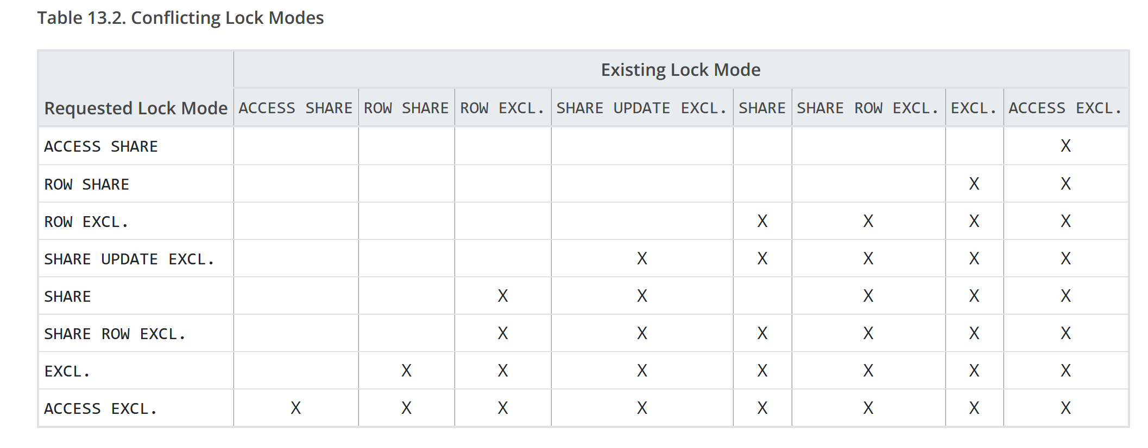
Locks in PostgreSQL

Slide 10
View pg_locks
As seen in the previous table there are locks also in PostgreSQL even if MVCC is implemented: https://www.interdb.jp/pg/pgsql05.html
Locks can be monitored from the system view pg_locks
Function pg_blocking_pids(pid) returns an array of integers with all the blocking pids. Pay attention that, as per official documentation:
Frequent calls to this function could have some impact on database performance, because it needs exclusive access to the lock manager's shared state for a short time.
https://www.postgresql.org/docs/current/view-pg-locks.html
Demo

Slide 11
pgAdmin
Information about what’s going on in our PostgreSQL Cluster directly from pgAdmin GUI.
Basically these information are a graphical representation of pg_stat_activity and pg_locks plus some other info on configuration and logs.
Info can be seen from the Dashboard tab
https://www.pgadmin.org/download/
Demo

Slide 12
Tracking execution statistics
Track query execution statistics using pg_stat_statements extension
pg_stat_statements tracks statistics across all databases of a cluster
pg_stat_statements extension add view, functions and configuration parameters
Views:
pg_stat_statements to access the query statistics
pg_stat_statements_info to see the info about statistics collected
Functions:
pg_stat_statements_reset to reset the statistics

Slide 13
pg_stat_statements Setup
Normally the extension package is already installed but maybe needed a:
sudo yum install postgresql-contrib
Add pg_stat_statements to shared_preload_libraries parameter in postgresql.conf (requires restart of PostgreSQL cluster)
Configurable parameters:
pg_stat_statements.max - Maximum number of tracked statements, default is 5000
pg_stat_statements.track – Which statements are counted, top, all or none. Default is top
pg_stat_statements.track_utility - Track commands other than SELECT, INSERT, UPDATE and DELETE. Default is ON
pg_stat_statements.track_planning – Track planning operations and duration. Default is OFF
pg_stat_statements.save - Whether save statement statistics across server shutdowns. Default is ON
https://www.postgresql.org/docs/current/pgstatstatements.html
Demo

Slide 14
Track VACUUM/AUTOVACUUM activities
In order to monitor VACUUM/AUTOVACUUM processes and the status of the tables/indexes to be vacuumed we can use the following cumulative stats views and extensions:
View pg_stat_progress_vacuum https://www.postgresql.org/docs/current/progress-reporting.html#VACUUM-PROGRESS-REPORTING
Catalog view pg_database in order to get available txid https://www.postgresql.org/docs/current/catalog-pg-database.html
Catalog view pg_class https://www.postgresql.org/docs/current/catalog-pg-class.html
Extension pgstattuple https://www.postgresql.org/docs/current/pgstattuple.html

Slide 15
Pg_stat_io
In order to dig deeper into I/O statistics, starting from PostgreSQL version 16, we can use the view pg_stat_io
Attention: it works only if parameter track_io_timing is set to on, can have significant overhead
https://www.postgresql.org/docs/current/monitoring-stats.html#MONITORING-PG-STAT-IO-VIEW
https://tembo.io/blog/optimizing-memory-usage

Slide 16
Summary
In this session we have seen multiple ways to monitor some of the key topics in PostgreSQL
It is by no means a complete list of the possibilities and I omitted all the monitoring tools products such as pganalyze and others
Questions?
https://posetteconf.com/2025/schedule/#livestream2

Slide 17
Grazie!!!

